Slide 1
📝 Collaborative Writing and Presentation

Slide 2
🤝 What is Collaborative Writing?
Definition
A process where multiple people work together to create a single written document or presentation.

Slide 3
🌟 Why Collaborative Writing?
💡 Different Perspectives
Unique ideas and viewpoints
📈 Better Quality
Multiple reviews = fewer errors
⏰ Efficient Work
Divide tasks and finish faster
🎯 Skill Development
Teamwork, communication, project management

Slide 4
📊 What is a Survey?
Definition
A research method to collect information and opinions from a group of people through structured questions.
🎯 Example Survey Topic
Topic: Students' Learning Preferences
Purpose: Understand how students learn best
Target Group: 16–18 years
Sample Size: 50–100 students

Slide 5
📋 Steps to Conduct a Survey
1. Define Purpose
What do you want to find out?
2. Choose Target Group
Who will you survey?
3. Create Questions
Profiling questions.
Mix open and closed-ended questions
4. Collect Data
Distribute and gather responses
5. Analyze Results
Create charts and find patterns

Slide 6
🎓 Questions on respondents’ profiles
Used to collect background information about the respondents
Name: _________________________
Age: ___________________________
Gender: ________________________
Course: ___________________
Institute: _________________
Email : _________________
💡 Choose whichever questions are appropriate for your survey — you don’t need to include all.
Profiling questions help identify who is responding, not their opinions or preferences.
.

Slide 7
❓ Types of Survey Questions
Closed-Ended Questions
Example 1: Do you prefer studying in the morning or evening?
a) Morning b) Evening
Example 2: How many hours do you study daily?
a) 1–2 hours b) 3–4 hours c) 5+ hours
Example 3: Rate your preference for online learning:
a) Love it b) Like it c) Neutral d) Dislike it
Open-Ended Questions
Example 1: What motivates you to study more effectively?
Answer: ____________
Example 2: Describe your ideal study environment
Answer: ____________
Example 3: What challenges do you face while studying online?
Answer: ____________

Slide 8
📝 Sample Mini-Survey:
Students' Learning Preferences
📝 Sample Mini-Survey: Students' Learning Preferences
4. How comfortable are you working or studying with others in a group? (Closed-ended)
a) Very uncomfortable b) Somewhat uncomfortable c) Neutral d) Comfortable e) Very comfortable
5. What challenges do you face while preparing for exams? (Open-ended)
Answer: _________________________
6. Which learning environment do you find most effective? (Closed-ended)
a) Online b) Offline c) Hybrid
1. When do you usually prefer to study? (Closed-ended)_x000b_ a) Morning b) Afternoon c) Evening d) Late Night_x000b__x000b_2. Which method helps you learn best? (Closed-ended)_x000b_ a) Visual aids (videos, diagrams) b) Audio methods (lectures)_x000b_ c) Reading materials d) Practical activities_x000b__x000b_3. What motivates you to study more effectively? (Open-ended)_x000b_ Answer: _________________________

Slide 9
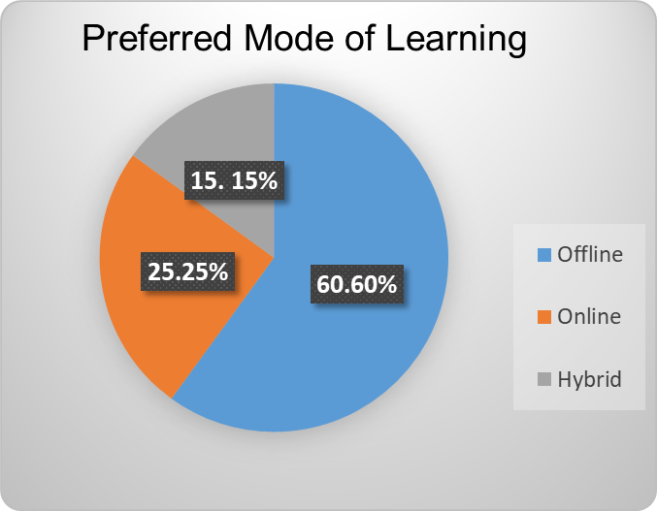
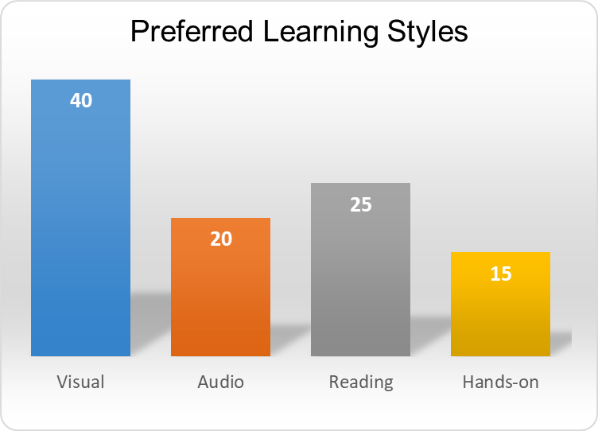
📊 Results of Mini-Survey
Key Takeaway
Most students prefer offline learning and visual methods, suggesting traditional classrooms with visual aids are most effective.

Slide 10
✍️ Understanding the Data
Instruction
Assess the survey findings
Example
The survey suggests that most students feel more comfortable learning in offline settings, indicating that classroom interaction is still highly valued. Visual learning stands out as the most preferred style, showing that students learn better when concepts are supported with diagrams, videos, or other visual aids. Overall, the findings highlight the importance of combining traditional teaching with visual methods to improve understanding and engagement.

Slide 11
🎤 Preparing the Presentation
1. Introduction
Topic, purpose, team
2. Methodology
How survey was conducted
3. Results
Charts, data, key findings
4. Conclusion
Summary and recommendations
5. Q&A
Answer audience questions

Slide 12
✅❌ Collaborative Presentation Tips
✅ Good Example
• Smooth transitions
• Eye contact
• Clear speaking pace
• Interactive elements
• Supporting teammates
❌ Bad Example
• Awkward handoffs
• Reading directly
• Too fast/quiet
• Ignoring audience
• Contradictions

Slide 13
🏆 Benefits of This Activity
Research Skills
Design surveys, analyze results
Teamwork
Collaborate, divide tasks
Communication
Present ideas clearly
Writing Skills
Structure & edit collaboratively
Data Analysis
Interpret charts
Project Management
Timelines, deadlines

Slide 14
🎯 Conclusion
Collaborative writing
Combines perspectives
Surveys
Collect valuable data
Data analysis
Reveals patterns
Effective presentations
Practice, teamwork
Teamwork skills
Essential for success
🚀 Remember
Great collaborative projects happen when everyone contributes their strengths!

